Slide 1


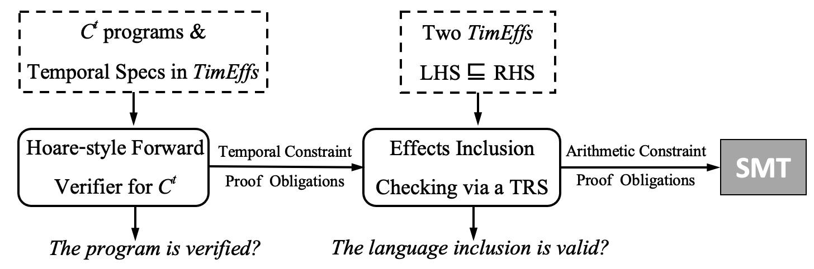
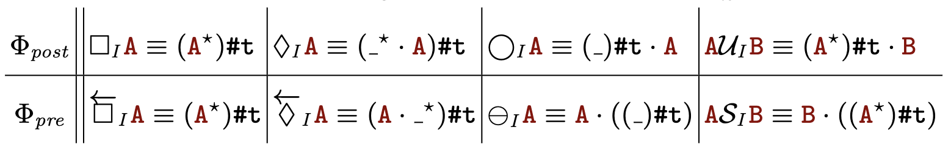
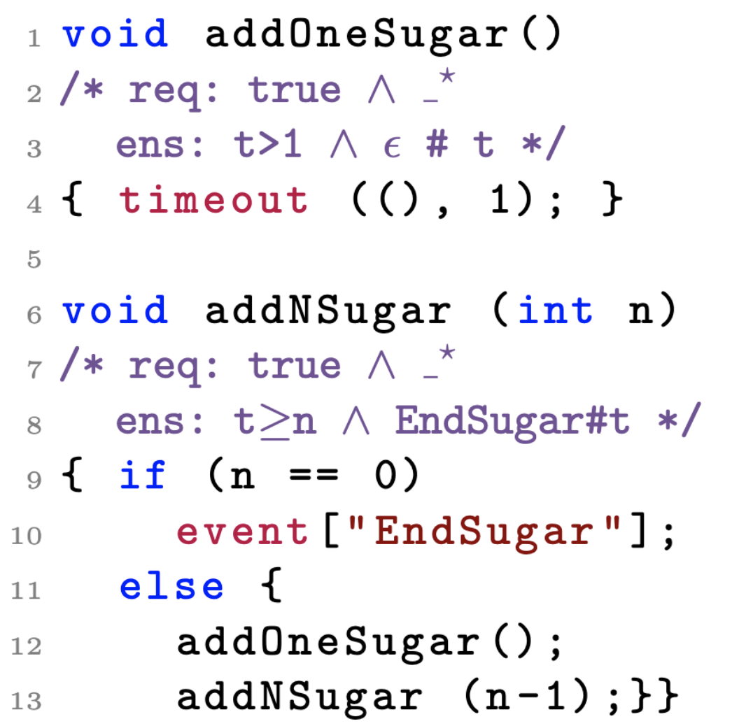
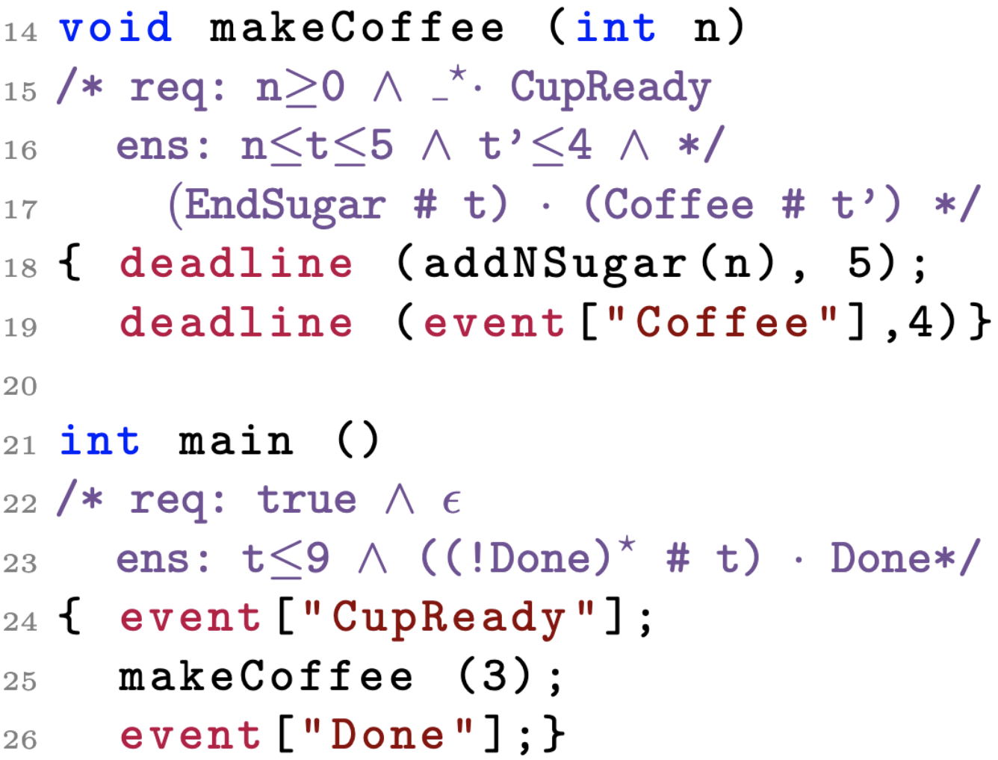
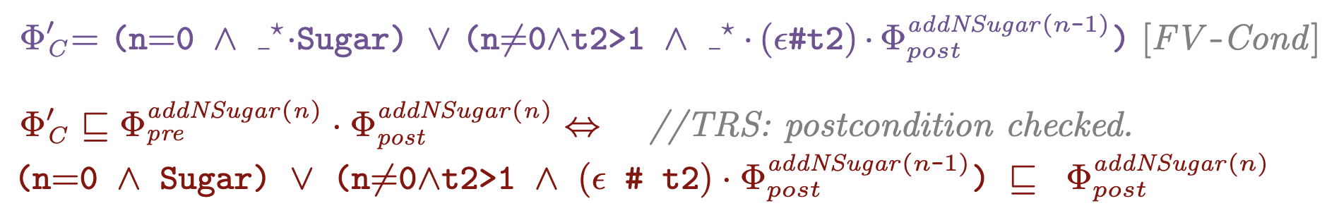
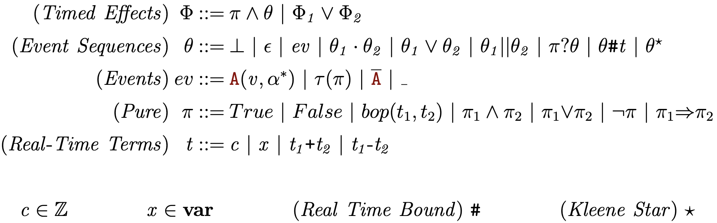
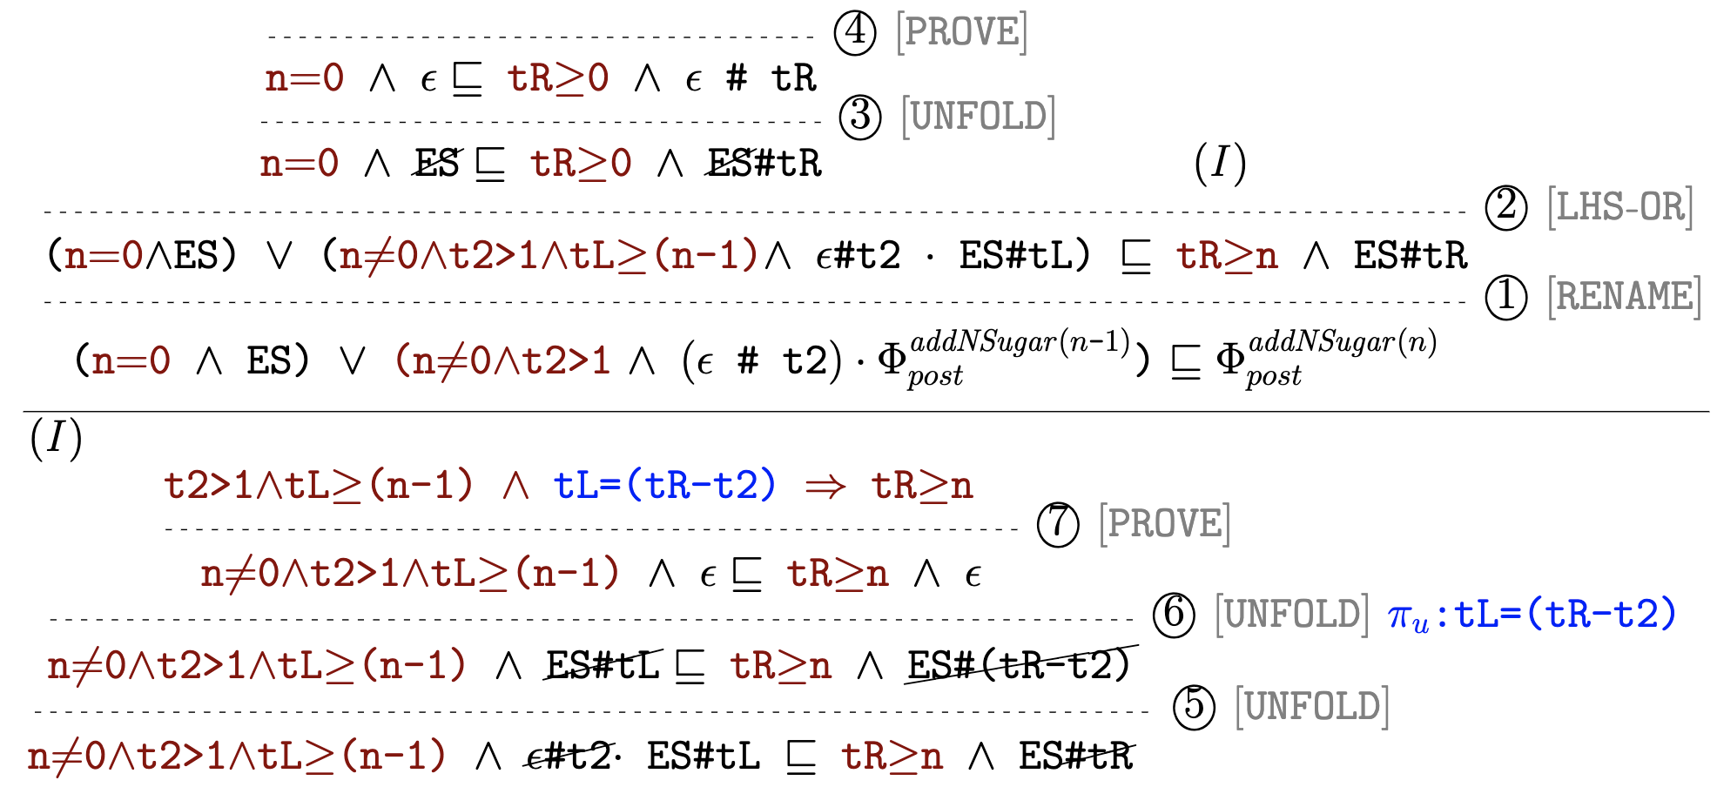


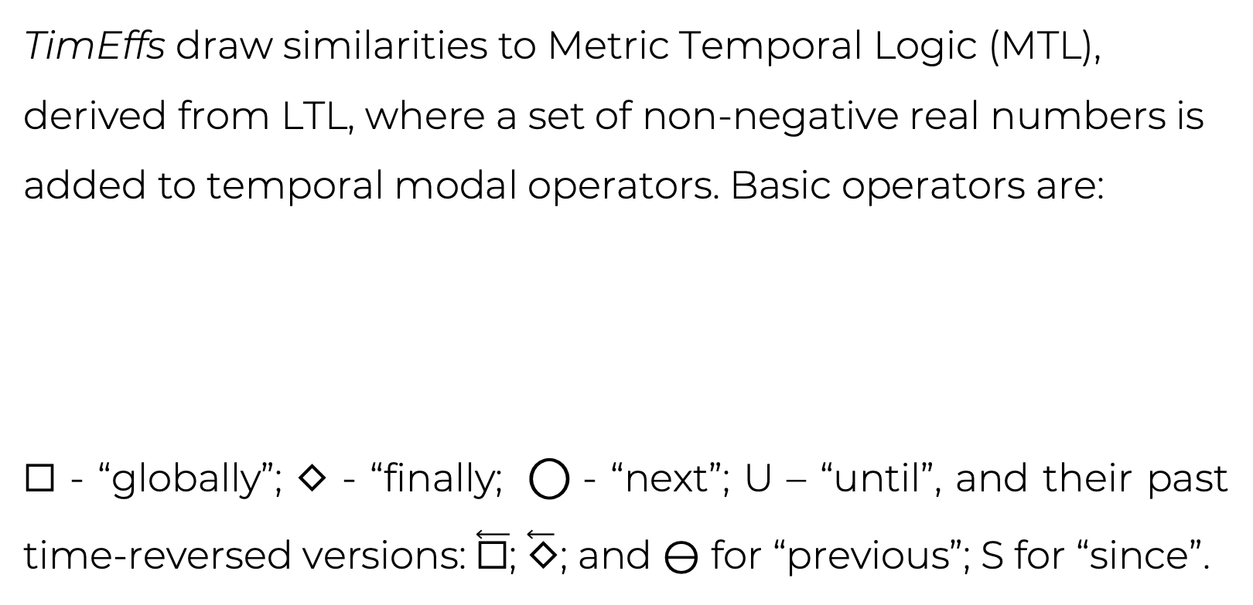
Automated Temporal Verification for Real-Time Systems
via Implicit Clocks and an Extended Antimirov Algorithm
Yahui Song @ SPLASH-SRC 2022 yahuis@comp.nus.edu.sg
Overview
Language Inclusion – the Antimirov Algorithm
To go beyond the existing Timed Automata (TA) based techniques, we propose a novel solution that integrates a modular Hoare-style forward verifier with a term rewriting system (TRS) on Timed Effects (TimEffs). The purposes are to: increase expressiveness, dynamically manipulate clocks, and efficiently solve clock constraints. The main contributions are:
Language Abstraction, C^{t}: generalizes the real-time systems with mutable variables and timed behavioural patterns.
Novel Specification, TimEffs: extends regular expressions with dependent values and arithmetic constraints.
Efficient Term Rewriting System, TRS: solves inclusions between TimEffs, by iterated checking of their derivatives.
Our proposal overcomes the following existing limitations:
TAs cannot be used to specify/verify incompletely specified systems, i.e., whose timing constants have yet to be known, and hence cannot be used in early design phases;
verifying a system with a set of timing constants usually requires enumerating all of them if they are integer-valued;
TAs cannot be used to verify systems with timing constants to be taken in a real-valued dense interval.
Our TRS is an extension of Antimirov and Mosses’ algorithm, which can be deployed to decide the inclusions of two regular expressions (REs) through an iterated process of checking the inclusions of their partial derivatives.
Definition 1 (Derivatives). Given any formal language S over an alphabet Σ and any string u∈ Σ* , the derivatives of S w.r.t u is defined as: u⁻¹S = {w ∈ Σ* | uw ∈ S}.
Definition 2 (Regular Expression Inclusion). For REs r and s,
r ⪯ s ⟺ ∀ A∈ Σ. A⁻¹(r) ⪯ A⁻¹(s) .
Definition 3 (TimEffs Inclusion). For TimEffs Φ₁ and Φ₂,
Φ₁ ⊑ Φ₂ ⟺ ∀ A∈ Σ. ∀ t≥0. (A#t)⁻¹ Φ₁ ⊑ (A#t)⁻¹ Φ₂ .
Antimirov V M, Mosses P D. Rewriting extended regular expressions[J]. Theoretical Computer Science, 1995, 143(1): 51-72.
Expressiveness of TimEffs
TimEffs draw similarities to Metric Temporal Logic (MTL), derived from LTL, where a set of non-negative real numbers is added to temporal modal operators. Basic operators are:
☐ - “globally”; ◇ - “finally; ⃝ - “next”; U – “until”, and their past time-reversed versions: $\overset{⃖}{\text{☐}}$; $\overset{⃖}{\text{◇}}$; and ⊖ for “previous”; S for “since”.
TimEffs (Symbolic Timed Automata)
TimEffs in the precondition, encode past-time temporal specifications. I in MTL is the time interval with concrete upper/lower bounds, whereas in TimEffs they can be symbolic bounds, dependent on program inputs.
A Demonstration of the Automated TRS
Limitation of Our TRS:
Our TRS is incomplete, meaning there exist valid inclusions which will be disproved in our system. That is mainly because of insufficient unification in favor of achieving automation.
Scan Me For the
Project Repository
Notes:
meaning there exist valid inclusions which
will be disproved in our system.
That is

